Slide 1

Excessively More Charts Assignment
David Berberena
DSC 640 Data Presentation and Visualization
Weeks 9 and 10
8/10/24

Slide 2
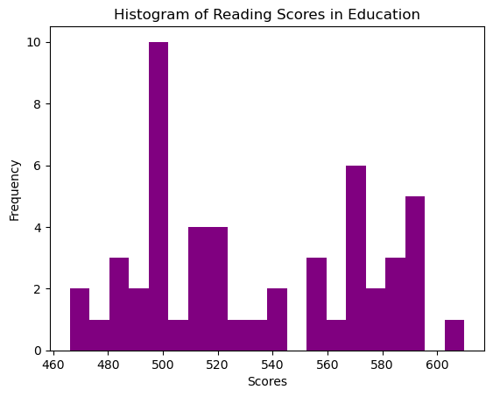
Python Histogram

Slide 3
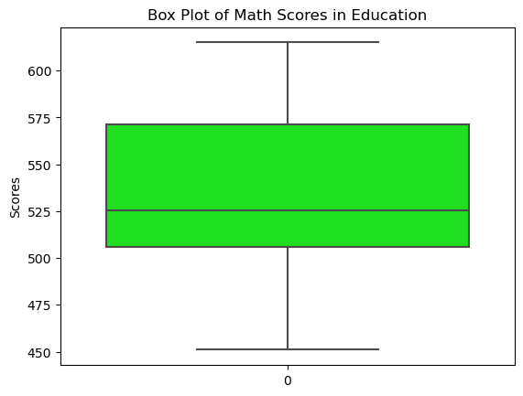
Python Box Plot

Slide 4
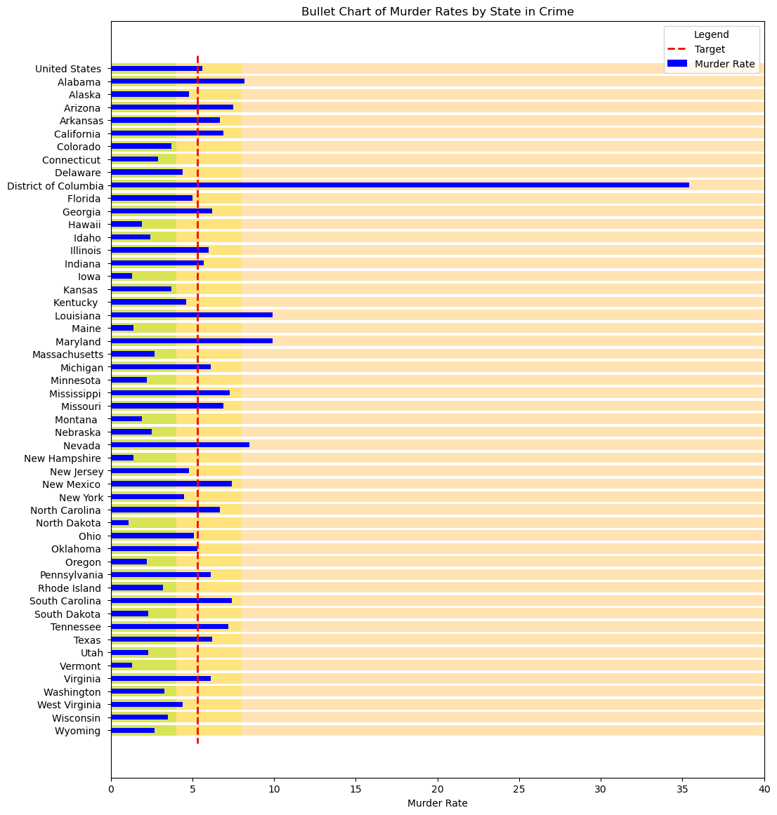
Python Bullet Chart

Slide 5
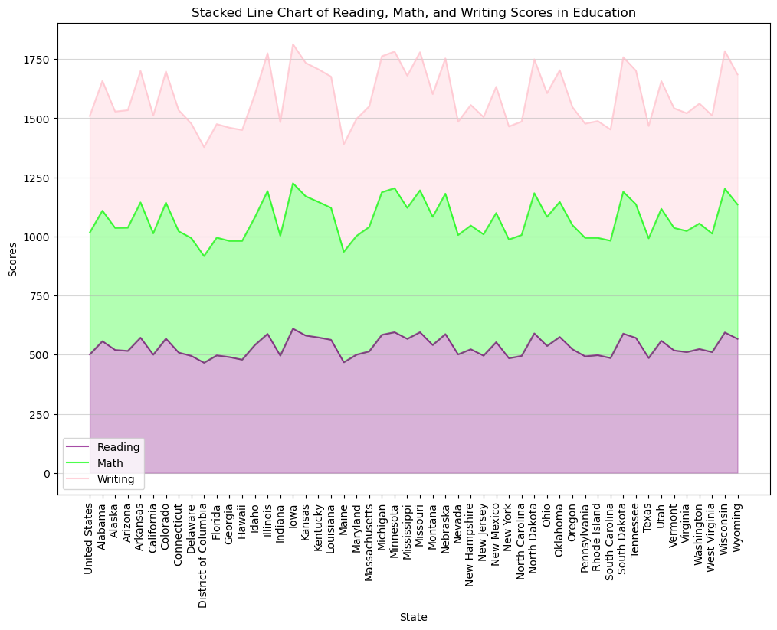
Python Stacked Line Chart

Slide 6
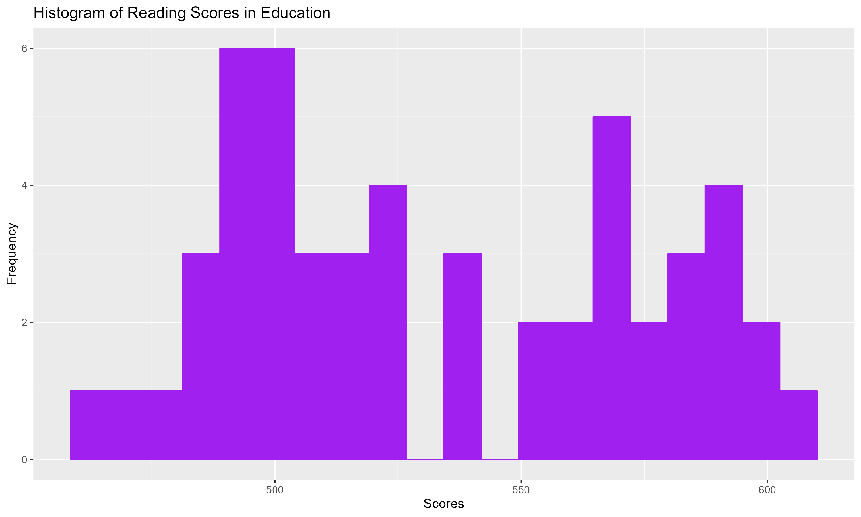
R Histogram

Slide 7
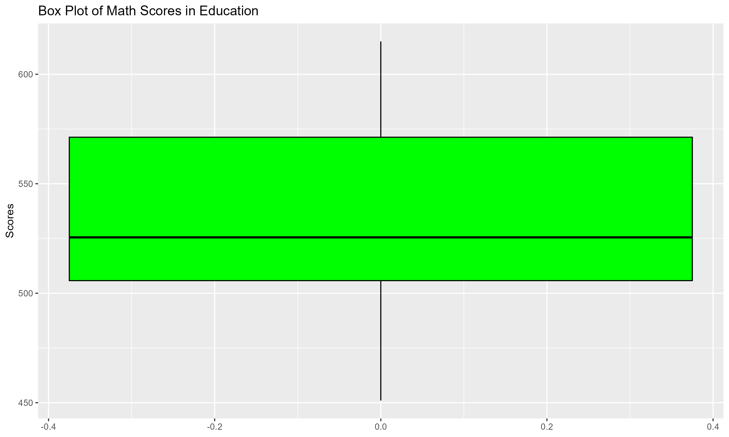
R Box Plot

Slide 8
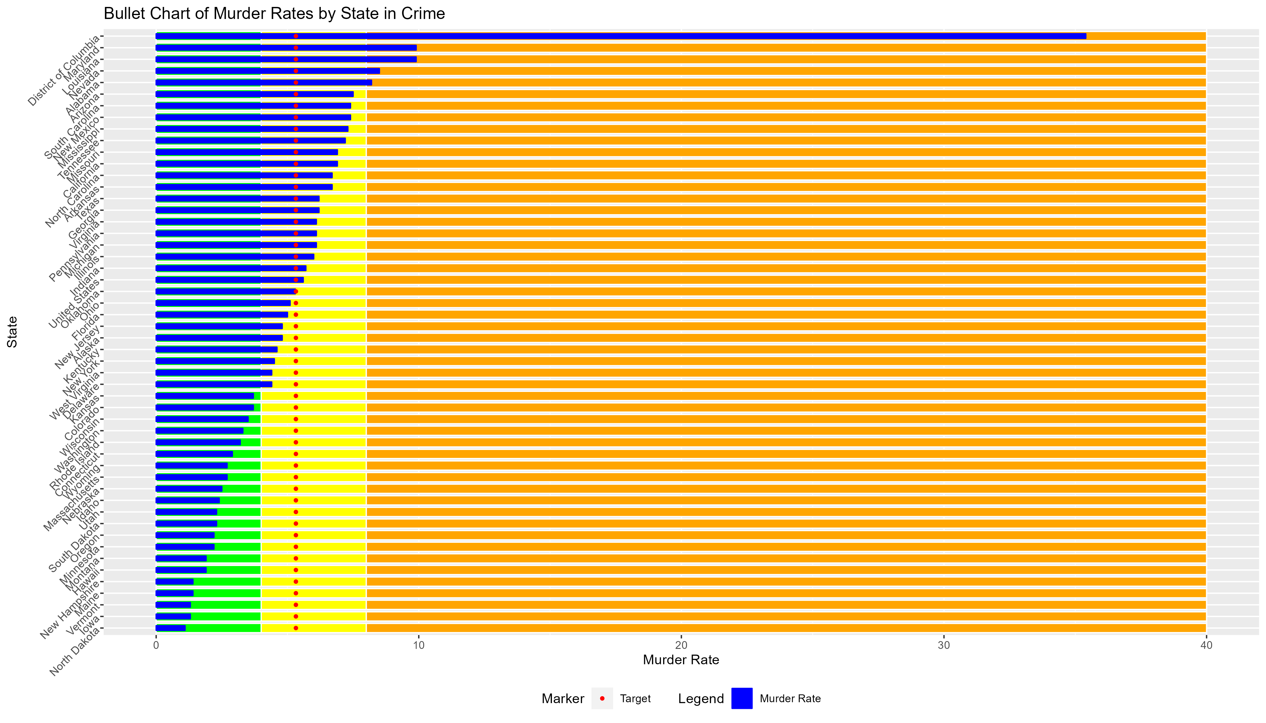
R Bullet Chart

Slide 9
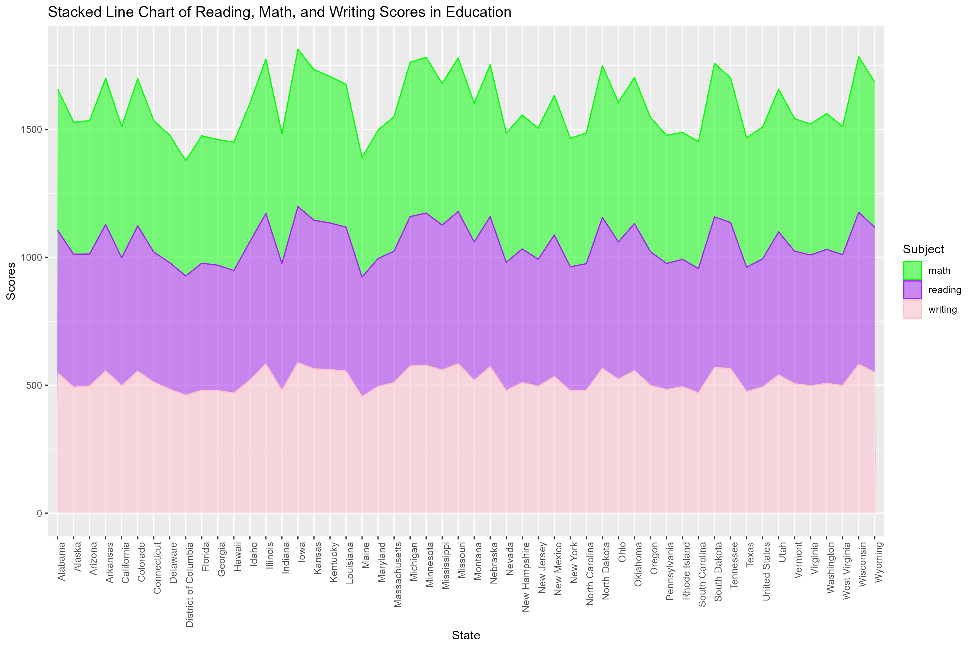
R Stacked Line Chart

Slide 10
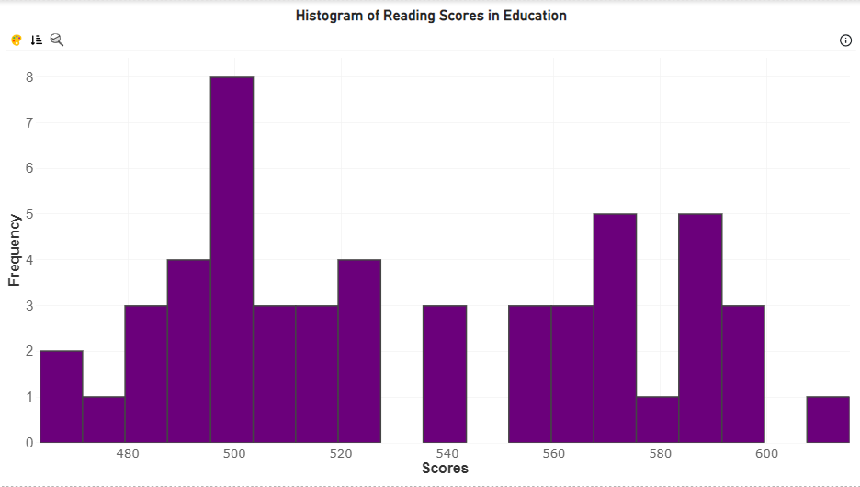
PowerBI Histogram

Slide 11
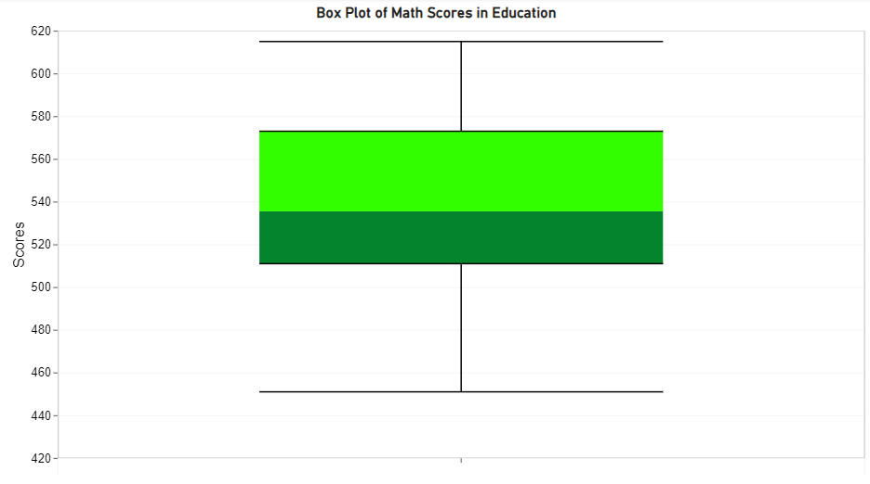
PowerBI Box Plot

Slide 12
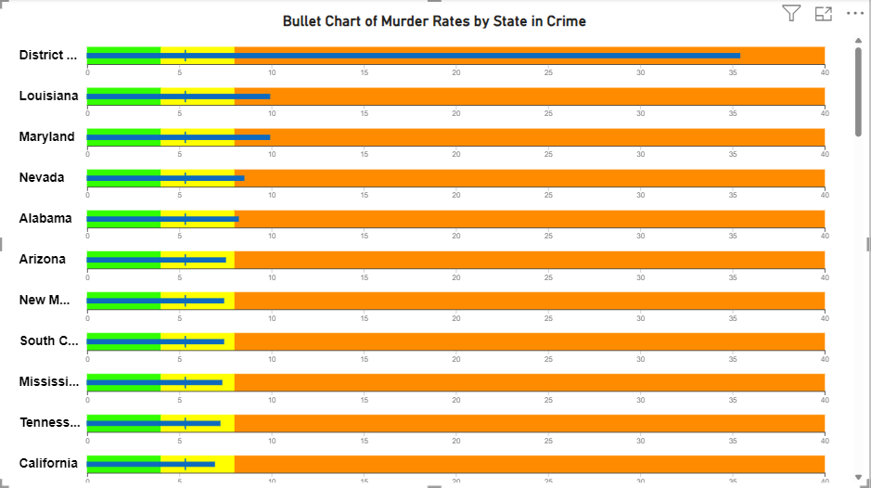
PowerBI Bullet Chart

Slide 13
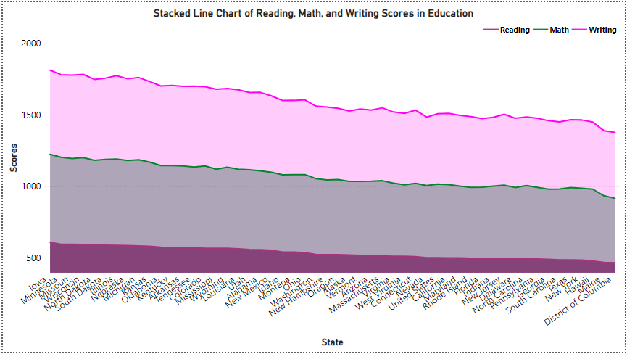
PowerBI Stacked Line Chart

